Slide 1
ADU Classifier
using Deep Learning with Transformers
Telmo Baptista | M.EIC | FEUP

Slide 2
Recap
Our objective is to classify the propositional content of ADUs from the Público newspaper into:
Facts;
Policies;
Negative Value;
Neutral Value;
Positive Value.
There’s two datasets:
Articles
Contains the raw article and its metadata;
ADUs
Contains the ADUs for the articles;
ADU may be annotated multiple times by different annotators;
Has its corresponding label.

Slide 3

Base Language Model
BERTimbau;
BERT-based for Portuguese language;
Trained on BrWaC (Brazilian Web as Corpus);
High scores on multiple tasks compared to its peers;
Contains base and large version:
Base - 110M parameters;
Large - 335M parameters (version used).
«BERTimbau Large is a pretrained BERT model for Brazilian Portuguese that achieves state-of-the-art performances on three downstream NLP tasks: Named Entity Recognition, Sentence Textual Similarity and Recognizing Textual Entailment»
Base Model in HuggingFace
https://huggingface.co/neuralmind/bert-large-portuguese-cased

Slide 4
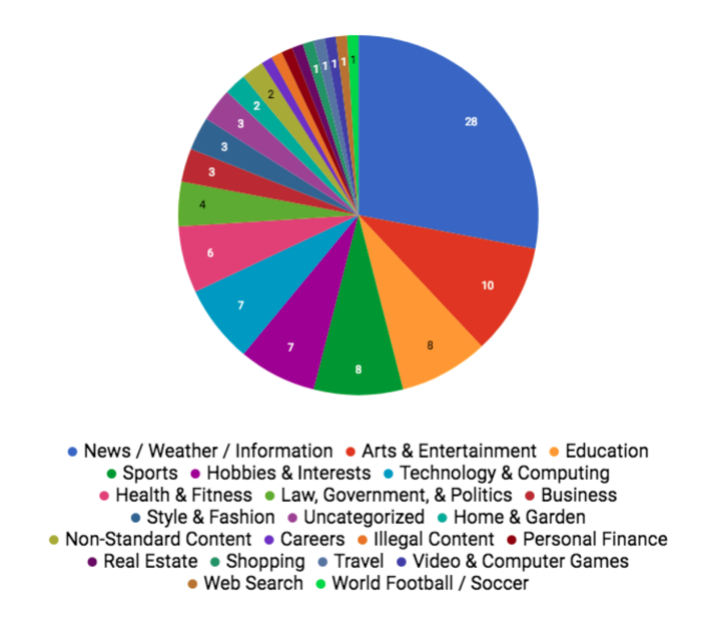
Domain Adaptation
Need to adapt language model to our domain:
Different language: European Portuguese vs Brazilian Portuguese;
Different context: News articles vs Variety of websites;
Trained using MLM (Masked Language Modelling) → objective is to obtain a better representation of input documents;
Intrinsic Evaluation for performance (perplexity).
Fig. 1 - brWaC Corpus website content distribution. Filho et al., 2018.

Slide 5
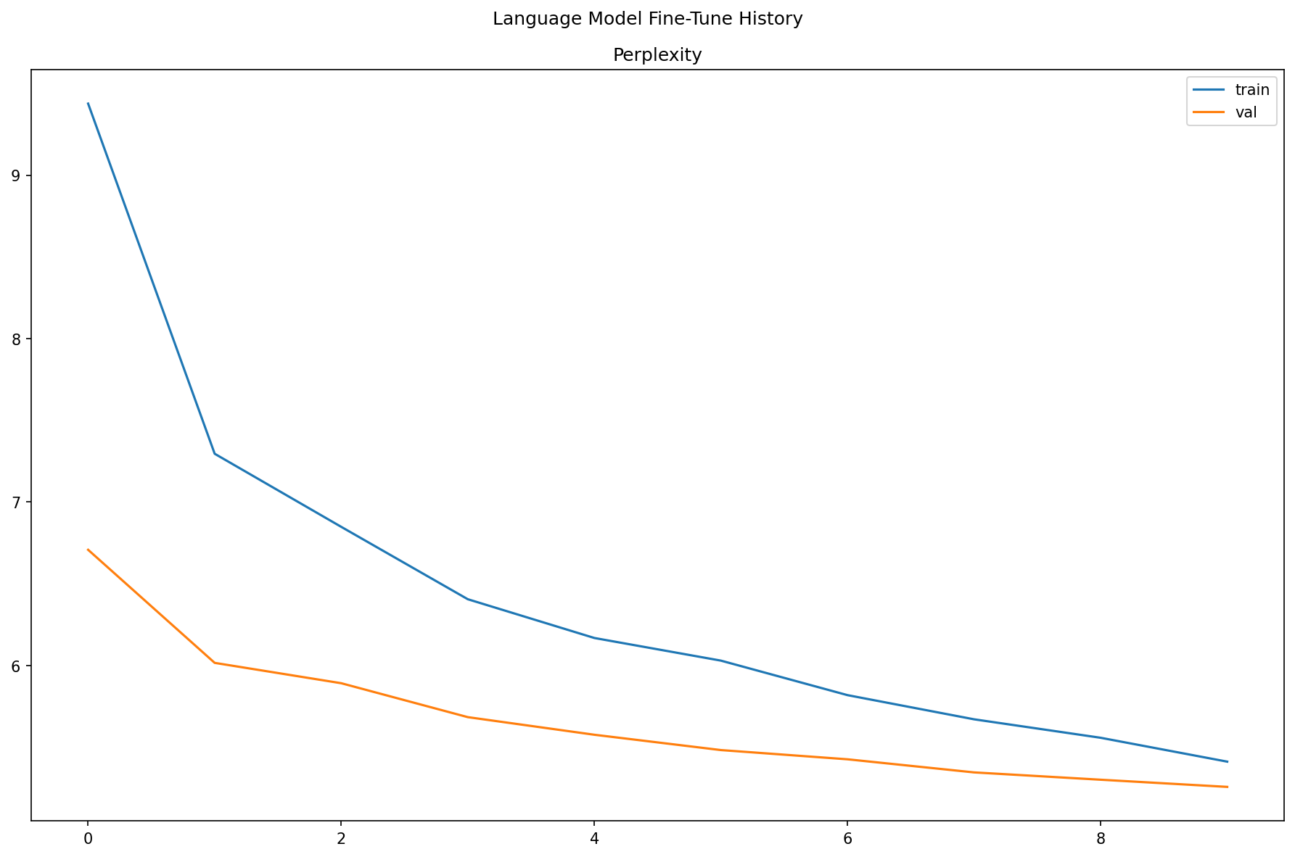
Domain Adaptation
Trained on articles dataset:
Training: 2914 chunks of 128 tokens (80%);
Validation: 729 chunks of 128 tokens (20%);
Masking probability: 20%;
Mini-batch training with size of 16 (shuffled);
AdamW optimizer:
Initial learning rate: 1e-5;
Additional linear decay on each epoch;
Trained for 10 epochs:
Best epoch: 10;
Perplexity: 5.257 (-44% compared to 1st epoch).
Fig. 2 - Perplexity evolution during MLM training.

Slide 6
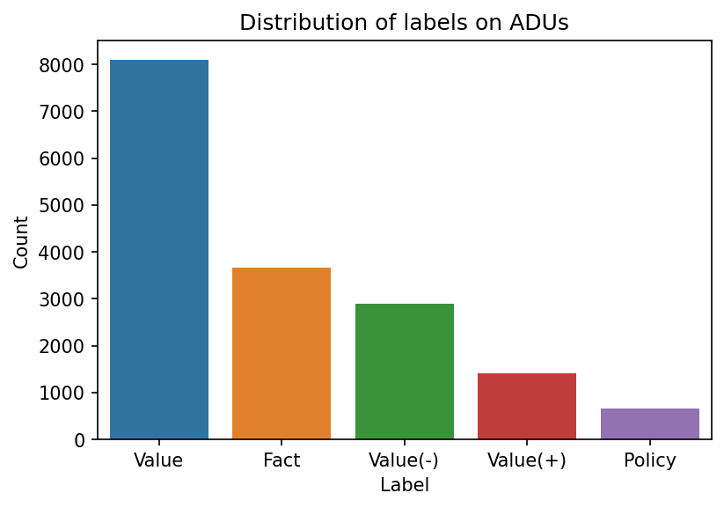
Text Classification - CLS_C
Trained on complete ADU dataset:
Training: 10716 ADUs (64%);
Validation: 2679 ADUs (16%);
Test: 3348 ADUs (20%)
Splits were made to ensure distribution of labels is maintained;
Dynamic data augmentation:
Random replacement of words by a random synonym;
Replacement probability: 30%;
Trained in two steps:
Freeze training;
Fine-tuning;
Objective: minimize loss in the validation set;
Evaluated on a variety of metrics:
Micro-accuracy, macro precision, recall, F1 score, others.
Fig. 3 - Label distribution on the ADUs dataset (complete dataset).

Slide 7
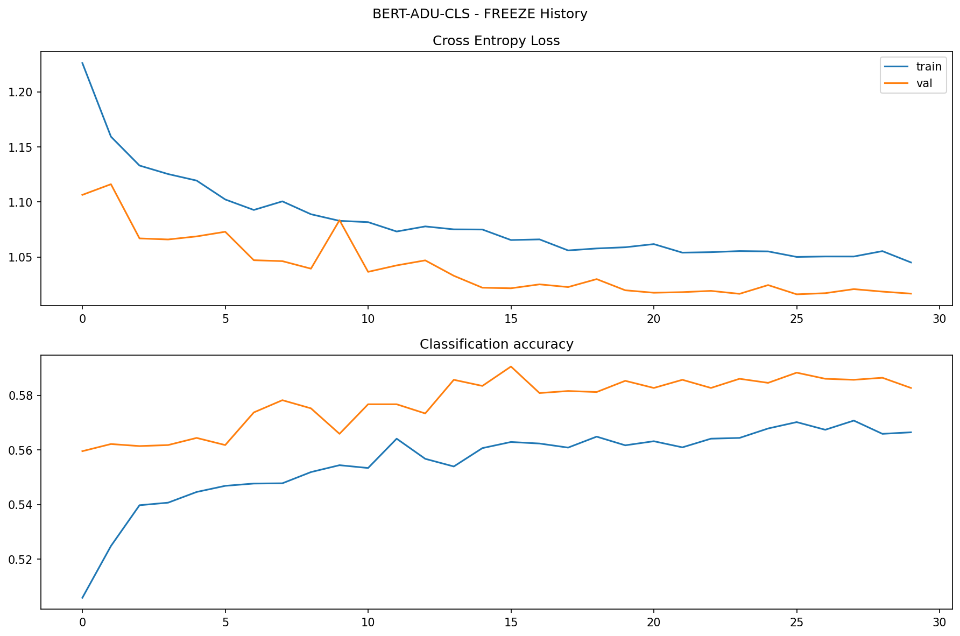
Text Classification - Freeze Training
Language model layers are frozen;
Mini-batch training with size of 64 (shuffled);
Adam optimizer:
Initial learning rate: 5e-3;
Exponential decay on each epoch;
Trained for 30 epochs:
Best epoch: 26;
Validation loss: 1.016;
Validation micro-accuracy: 58.83%;
Small improvement to expected;
Model stagnated → more epochs won’t improve performance;
Fig. 4 - Loss and micro-accuracy evolution on freeze training stage.

Slide 8
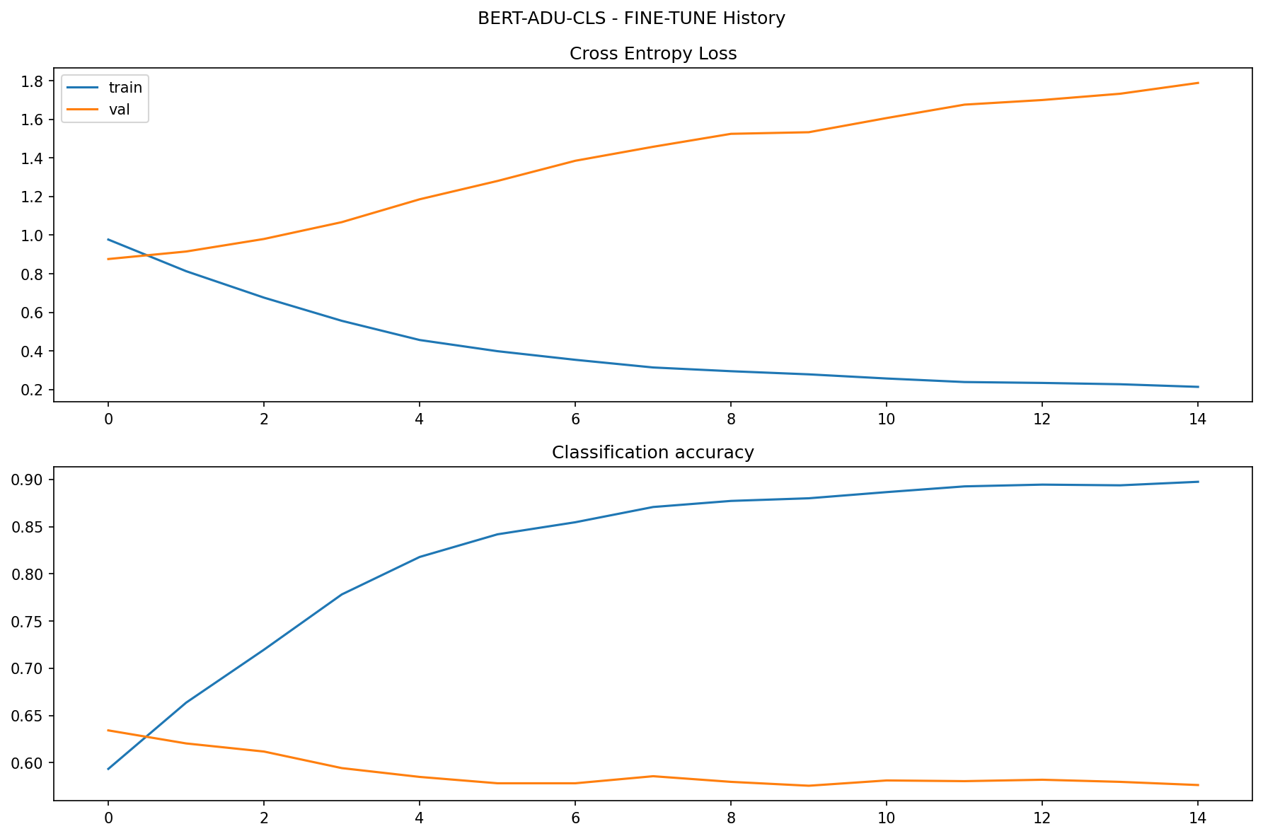
Text Classification - Fine-tuning
Language model layers are now unfrozen;
Objective: try to push model out of local minima;
Mini-batch training with size of 16 (shuffled);
Adam optimizer:
Initial learning rate: 1e-5;
Exponential decay on each epoch;
Trained for 15 epochs:
Best epoch: 1;
Validation loss: 0.876;
Validation micro-accuracy: 63.41%;
Overfitted after first epoch.
Fig. 5 - Loss and micro-accuracy evolution on fine-tuning stage.

Slide 9
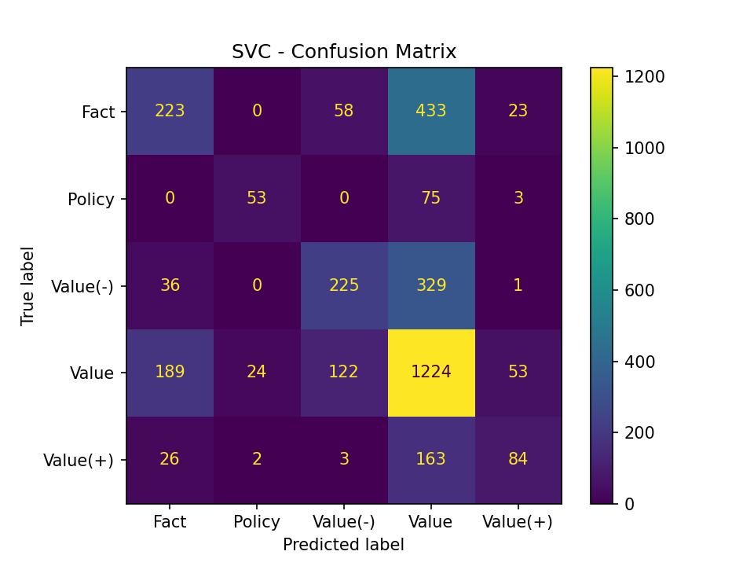
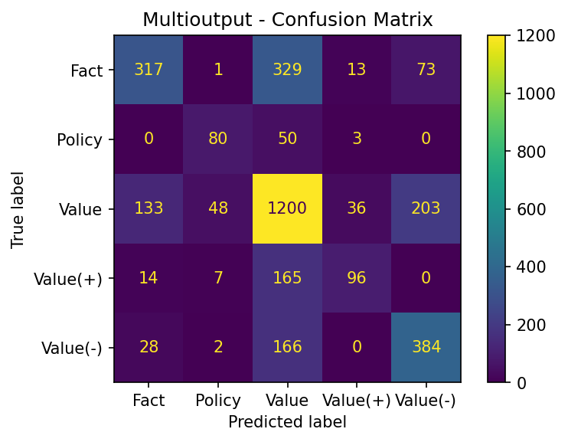
Text Classification - Evaluation
CLS_C
Fig. 6 - Confusion matrix for SVC (first project).
Fig. 7 - Confusion matrix for CLS_C.

Slide 10
Text Classification - Evaluation
SVC:
Micro-accuracy: 54%
CLS_C:
Micro-accuracy: 62%
 | Precision | Recall | F1-Score
Fact | 0.47 | 0.30 | 0.36
Policy | 0.67 | 0.40 | 0.50
Value | 0.55 | 0.75 | 0.63
Value(+) | 0.51 | 0.30 | 0.38
Value(-) | 0.55 | 0.38 | 0.45
Weighted Avg | 0.53 | 0.54 | 0.52
 | Precision | Recall | F1-Score
Fact | 0.64 | 0.43 | 0.52
Policy | 0.58 | 0.60 | 0.59
Value | 0.63 | 0.74 | 0.68
Value(+) | 0.65 | 0.34 | 0.45
Value(-) | 0.58 | 0.66 | 0.62
Weighted Avg | 0.62 | 0.62 | 0.61
Table. 1 - Classification report for SVC (first project).
Table. 2 - Classification report for CLS_C.

Slide 11
Text Classification - Evaluation
Is the accuracy obtained really accurate? No.
There’s conflicts in annotations on the dataset, and they weren’t treated here, let’s look at some “errors”.
ADU | Target | Predicted
“Em dezembro do ano passado Fernando Medina avançou com a proposta de obras profundas na Segunda Circular” | Value | Fact
“É tudo cómico na FIFA” | Value(+) | Value(-)
“Referindo-se aos incidentes, o presidente da UEFA, Michel Platini, afirmou estar muito triste com o sucedido” | Value(-) | Fact
Table. 3 - CLS_C errors on testing set.

Slide 12
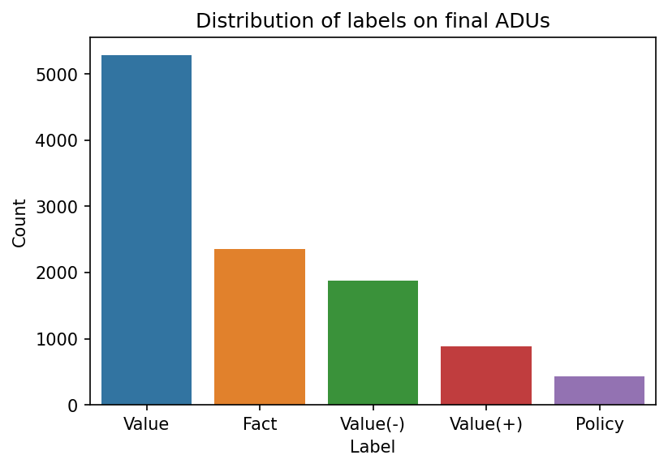
Text Classification - CLS_NC
Same in architecture to CLS_C but trained on dataset that doesn’t contain conflicted ADUs:
Conflicts are resolved by majority wins, if tied both are eliminated;
Trained on non-conflict ADU dataset:
Training: 6936 ADUs (64%);
Validation: 1469 ADUs (16%);
Test: 1787 ADUs (20%)
Splits were made to ensure distribution of labels is maintained;
Fig. 8 - Label distribution after removing conflicted ADUs.

Slide 13
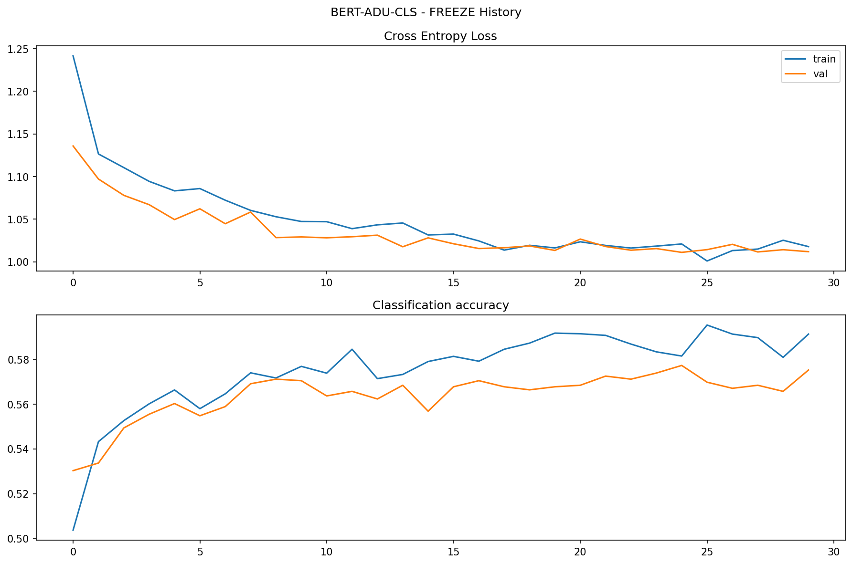
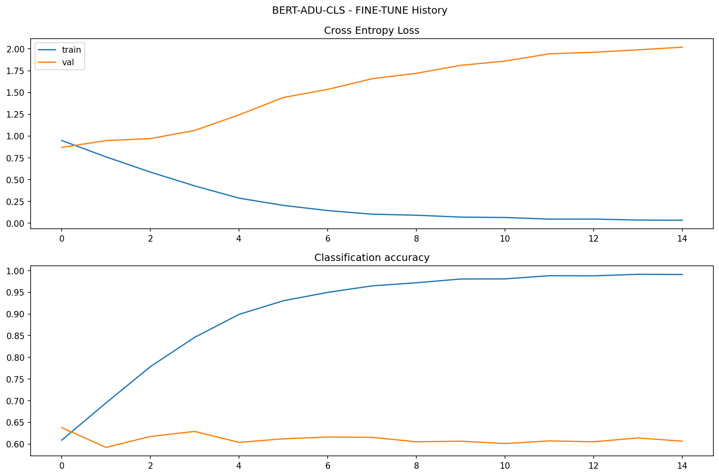
Text Classification - Training stages
Freeze training for 30 epochs:
Best epoch: 25;
Validation loss: 1.011;
Validation micro-accuracy: 57.77%;
Fine-tuning for 15 epochs:
Best epoch: 1;
Validation loss: 0.869;
Validation micro-accuracy: 63.78%;
Fig. 9 - Loss and micro-accuracy evolution on freeze training stage.
Fig. 10 - Loss and micro-accuracy evolution on fine-tuning stage.

Slide 14
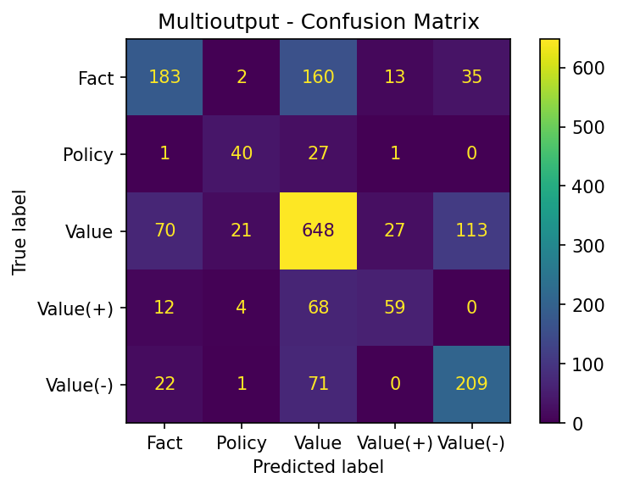
Text Classification - Evaluation
CLS_NC
CLS_NC:
Micro-accuracy: 64%
 | Precision | Recall | F1-Score
Fact | 0.64 | 0.47 | 0.54
Policy | 0.59 | 0.58 | 0.58
Value | 0.67 | 0.74 | 0.70
Value(+) | 0.59 | 0.41 | 0.49
Value(-) | 0.59 | 0.69 | 0.63
Weighted Avg | 0.64 | 0.64 | 0.63
Fig. 11 - Confusion matrix for CLS_NC.
Table. 4 - Classification report for CLS_NC.

Slide 15
Mix-and-Match Experiment
What if we now use the classifier trained on conflicted dataset to classify the non-conflicted dataset?
CLS_NC:
Micro-accuracy: 64%
CLS_C:
Micro-accuracy: 70%
 | Precision | Recall | F1-Score
Fact | 0.64 | 0.47 | 0.54
Policy | 0.59 | 0.58 | 0.58
Value | 0.67 | 0.74 | 0.70
Value(+) | 0.59 | 0.41 | 0.49
Value(-) | 0.59 | 0.69 | 0.63
Weighted Avg | 0.64 | 0.64 | 0.63
 | Precision | Recall | F1-Score
Fact | 0.71 | 0.48 | 0.57
Policy | 0.68 | 0.75 | 0.72
Value | 0.69 | 0.82 | 0.75
Value(+) | 0.77 | 0.42 | 0.54
Value(-) | 0.69 | 0.74 | 0.71
Weighted Avg | 0.70 | 0.70 | 0.69
Table. 4 - Classification report for CLS_NC.
Table. 5 - Classification report for CLS_C in the non-conflict dataset.

Slide 16
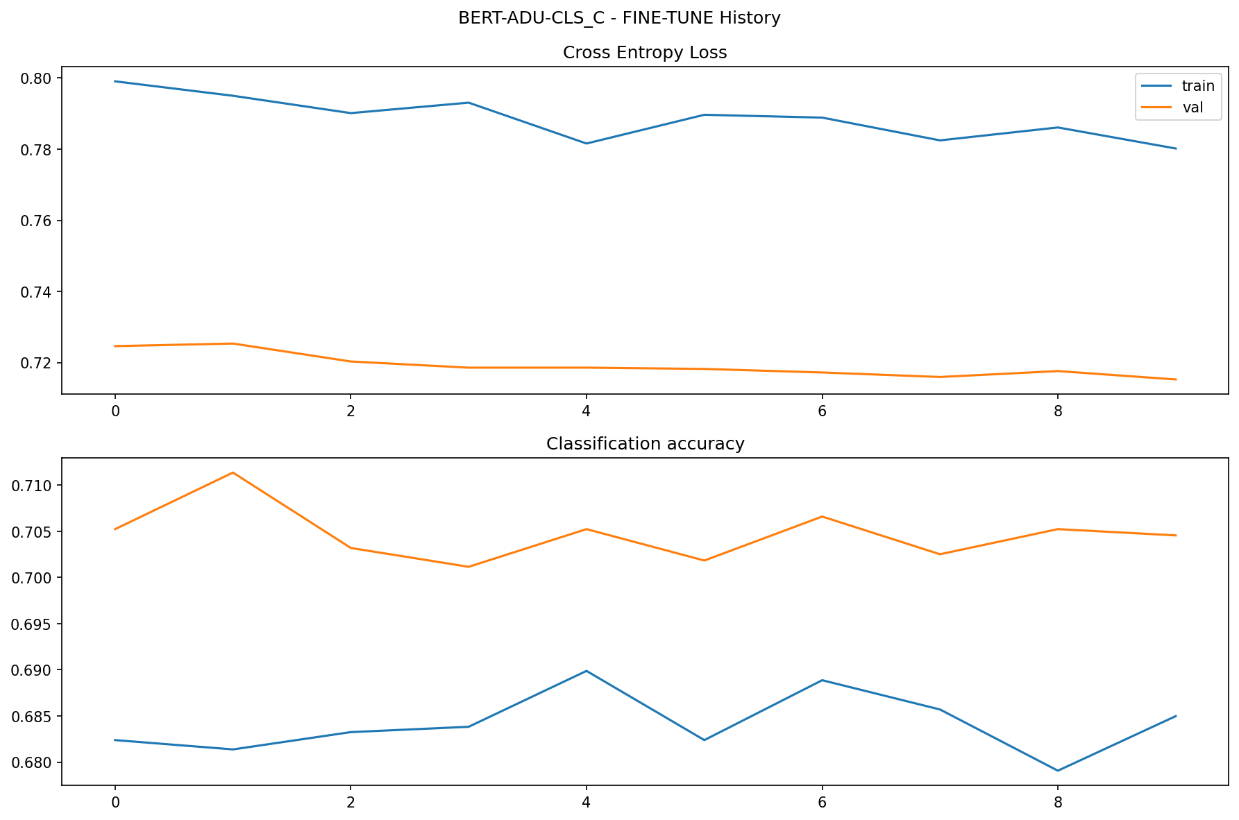
Text Classification - Fine-tuning²
Fine-tune CLS_C model on the dataset without conflicted ADUs;
Language model frozen → unfrozen lead to overfit previously;
Objective: try to push model out of local minima;
Mini-batch training with size of 64 (shuffled);
Adam optimizer:
Initial learning rate: 1e-4;
Trained for 10 epochs:
Best epoch: 10;
Validation loss: 0.715;
Validation micro-accuracy: 70.45%;
Fig. 12 - Loss and micro-accuracy evolution on fine-tuning stage.

Slide 17
Text Classification - Evaluation²
CLS_C:
Micro-accuracy: 70%
CLS_C²:
Micro-accuracy: 71%
 | Precision | Recall | F1-Score
Fact | 0.71 | 0.48 | 0.57
Policy | 0.68 | 0.75 | 0.72
Value | 0.69 | 0.82 | 0.75
Value(+) | 0.77 | 0.42 | 0.54
Value(-) | 0.69 | 0.74 | 0.71
Weighted Avg | 0.70 | 0.70 | 0.69
 | Precision | Recall | F1-Score
Fact | 0.70 | 0.52 | 0.60
Policy | 0.65 | 0.78 | 0.71
Value | 0.71 | 0.82 | 0.76
Value(+) | 0.74 | 0.51 | 0.61
Value(-) | 0.71 | 0.71 | 0.71
Weighted Avg | 0.71 | 0.71 | 0.70
Table. 6 - Classification report for CLS_C in the non-conflict dataset.
Table. 7 - Classification report for CLS_C² in the non-conflict dataset.

Slide 18
Wrapping it up
Proposed model: CLS_C²;
 | SVC* | CLS_NC | CLS_C | CLS_C²
Precision | 53% | 64% | 70% | 71%
Recall | 54% | 64% | 70% | 71%
F1-Score | 52% | 63% | 69% | 70%
Accuracy | 54% | 64% | 70% | 71%
Precision, recall and F1-scores are the weighted averages, and accuracy corresponds to the micro-accuracy on the non-conflicted ADU dataset.
*This model wasn’t tested on the non-conflicted ADU dataset, but in the conflicted ADU dataset.
Table. 8 - Performance of developed models on the non-conflicted ADU dataset (see note above).

Slide 19
Conclusions & Future work
The tuning of the language model in the domain adaptation phase wasn’t deeply explored, so there’s potential improvement there, including making data augmentation on that phase (which wasn’t performed);
The developed models all stagnated at the final results shown, one approach that wasn’t implemented here but can potentially improve the performance is passing the neighbourhood of the ADU from the article as context for the model (“Context matters!: identifying argumentative relations in essays”, https://dl.acm.org/doi/10.1145/3477314.3507246);
In the mix-n-match phase it was also tested how the model CLS_NC performed on the conflicted dataset, and it also was better than the original model trained there (achieving 66% compared to 62% by CLS_C), but the fine-tuning wasn’t explored and can be another experiment. Although, it will most likely stagnate like CLS_C².
Lastly, the quality of the dataset itself is also a factor on the performance of these models, and could be treated better to achieve better results.

Slide 20
Thanks
Any questions?

